Slide 1
Poverty in Saint John
Helping Hands

Slide 2
Facts
Poverty costs New Brunswick $2 billion/year
Poverty costs New Brunswickers $2700/person/year
Provincial Poverty Rate 13.5%
Saint John Poverty Rate 20.8%
Saint John has the second highest rate of single parents living in poverty in Canada (1996 Census Stats).
Children Living in Poverty in Saint John - 1 in 4
Under the age of 18 – 28%
Under the age of 6 – 34%
Partnerships are vital to alleviate poverty.

Slide 3
Facts – cont’d
The Romero House soup kitchen serves hot food to about 300 people each day
Lunch Connection feeds 500 Saint John school kids with help from business and church sponsors.
The local Boys and Girls Club feeds another 100.
http://www.cbc.ca/news/canada/new-brunswick/saint-john-tied-with-toronto-for-highest-child-poverty-rates-1.2748919

Slide 4
Facts – cont’d
81% of the school population live in a provincially designated priority neighbourhood
87% of those living in the priority negihbourhood are 3rd generation dwellers.
50+% of our students reside in a single parent home
The average annual income is < $18,000
60+% of the current student body is identified with either cognitive or social emotional concerns

Slide 5
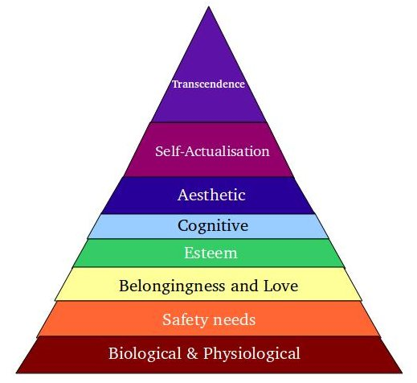
Maslow’s Hierarchy of Needs

Slide 6
BCAPI
The Business Community Anti-Poverty Initiative (BCAPI) was founded in 1997 in Saint John, New Brunswick by civic minded business leaders and professionals who wanted to move beyond charity and substantially reduce poverty in Saint John.
BCAPI focusses on increasing opportunities for children, youth and single-parents living in poverty to succeed in school and achieve employment that pays a decent wage. Second to this, is ensuring there are adequate resources in low-income neighbourhoods and schools to help low-income families improve their well-being, work toward economic self-sufficiency, and feel valued as contributing members of a vibrant community.

Slide 7
BCAPI –Goals
Enable children who live in poverty to succeed in school and break the poverty cycle.
Reduce the incidence of teenage pregnancy by enhancing youth programs that prevent pregnancy and improve well-being.
Develop services that enable young parents to continue their education and achieve adequate incomes.
Help single parents get into the workforce and off social assistance.
Help ‘at risk’ teens and young adults complete their high school education, be ready for post-secondary pursuits and the workforce.

Slide 8
BCAPI –goals (cont’d)
Promote solutions to the lack of adequate and affordable housing in Saint John, the need for mixed income neighbourhoods, and the regeneration of priority neighbourhoods.
Help others understand poverty, how it can be reduced and prevented, what is working in Saint John, and BCAPI’s ‘catalyst’ role.
Facilitate a community-led and comprehensive approach to poverty reduction that involves all sectors of the community.
Foster the continued growth of BCAPI.

Slide 9
Human Development Council
The Human Development Council provides information about community services throughout New Brunswick.
The Council works collaboratively with community agencies, individuals, government departments, businesses, churches, and labour to initiate, develop and implement creative strategies to meet the needs of the community.

Slide 10
Vibrant Communities Saint John
Vibrant Communities Saint John was created in 2004 to support the development and implementation of a poverty reduction plan in Saint John. The global objective to reduce poverty in Saint John to the National average (15%) from 28%, at the time by 2015. A second objective to reduce the child poverty rate to single digits from 28% by 2020 was set in 2009.

Slide 11
VCSJ - goals
VCSJ works closely with many partners to:
Lead and maintain the regional poverty reduction strategy;
Coordinate across sectors and among partners to implement the priorities of poverty reduction;
Stimulate Neighbourhood Revitalization;
Support workforce participation among low-income adults;
Assist children from cradle to career to succeed in school; and
Evaluate and communicate progress.

Slide 12
PALS
PALS was developed to help local schools enrich learning opportunities for children. While all schools can benefit from PALS, BCAPI focuses on seven schools located in Saint John’s low-income neighbourhoods. Local businesses and community organizations partner with neighbourhood schools, and provide support in the form of volunteers and financial assistance. The PALS model was founded in 2000 by Mr. J. K. Irving, Chairman of J.D. Irving, Limited in partnership with former School District 8 (now ASD-S), and has received national and international recognition for its excellence. Today, more than 100 organizations and 1,000 volunteers contribute to PALS in Saint John

Slide 13
Community Schools Program
Each of Saint John’s priority neighbourhoods has at least one community school, reaching outside its walls to create a unique community of learning. There are seven community schools (an initiative of the Department of Education) in former School District 8 (now ASD-S); with over 80 business and community partners. Each of these schools has PALS (Partners Assisting Local Schools) partnerships.
Each community school develops its own plan, but most have after-school programs, family activities, adult education, mentors, breakfast and lunch programs, and health services for children and their parents. Students increase their self-confidence, get better test scores, and learn the value of giving back to their community. Schools benefit from added resources, but also ‘people power’ to enrich their school experiences.

Slide 14
Community Schools
Centennial School
St. Patrick’s School
St. John the Baptist-King Edward School
Hazen White-St. Francis School
Glen Falls School
Lorne Middle School
Prince Charles School

Slide 15
P.R.O. Kids
P.R.O. Kids is a non-profit program operating out of the Leisure Services Department of the City of Saint John that enables children and teens, whose families don’t have the financial means, to participate in an arts, cultural, recreational or sport activity of their choice.

Slide 16
Early Childhood Development Coalition
Under the leadership of the Saint John Early Childhood Development Coalition, BCAPI has been working with local service providers to strengthen early learning and childcare resources for young children and their parents. In 2008, a business case was made for Saint John’s first Early Learning Centre – a comprehensive program that serves a neighbourhood. In 2010, the first ELC opened its doors at St. John the Baptist-King Edward School thanks to many partnerships provided by business, government and community organizations. Its success will help lay the groundwork for the growth of quality early childhood programs for families throughout Saint John and New Brunswick.

Slide 17
The Resource Centre for Youth
TRC is a safe, energetic place for teens to access free recreation; self-development programs; health and wellness services; and assistance with school studies and employment. Drawing from best practices and ‘youth engagement’ principles, the TRC helps teens from all walks of life become leaders and active participants in their community. TRC also provides services for homeless youth, and outreach services and programs for schools and neighbourhoods.

Slide 18
Bibliography
http://sjhdc.ca/pdf/atb11.pdf
http://sjhdc.ca/
http://bcapi.ca/
http://www.vibrantsj.ca/main.html

